Slide 1


AGI1242- MACHINE LEARNING TECHNIQUES
Department of Artificial intelligence and Data science
Academic Year: 2026 – 2027 (Odd Semester)
COURSE RECOMMENDATION SYSTEM
PRESENTED BY
2503811724322116 - VIDHYAA SHRI R
2503811724322118 - VINOTHINI S
2503811724321120 - VISHAL B
2503811724321124 - VISVESWARAN S
2503811724321126 - YOKESH M P M

Slide 2

PRESENTATION OVERVIEW
Objective
Problem Identification
Flow Diagram
Literature survey
Research methodology
Compare algorithm
Implementation Idea
Modules
Conclusion

Slide 3
OBJECTIVE
To develop a personalized course recommendation system.
To analyze student skills, interests, and preferences.
To recommend relevant courses using Machine Learning.
To rank courses based on their similarity and relevance.
To improve the student's learning experience.

Slide 4
PROBLEM IDENTIFICATION
Students face difficulty choosing the right course from numerous options.
Generic course lists do not consider individual interests and skills.
Manual course selection is time-consuming.
Students may choose courses that do not match their skill level.
A personalized recommendation system can solve this problem

Slide 5
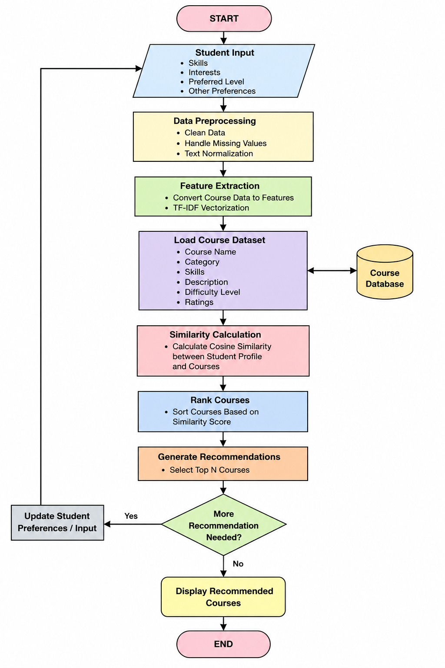
FLOW DIAGRAM

Slide 6
LITERATURE SURVEY
S.No | Year | Research Paper | Technique
1 | 2023 | Systematic Review of Recommendation Systems for Course Selection | Machine Learning
2 | 2023 | DORIS: Personalized Course Recommendation System Based on Deep Learning | Deep Learning
3 | 2023 | Analytical Review and Study on Various Course Recommendation Systems | ML & Data Mining
4 | 2023 | Course Recommendation Based on Enhancement of Meta-Path Embedding in Heterogeneous Graph | Graph Embedding
5 | 2023 | Machine Learning Based MOOC Course Recommendation System | Machine Learning

Slide 7
LITERATURE SURVEY
S.No | Year | Research Paper | Technique
6 | 2024 | Dynamic Educational Recommender System Based on Improved LSTM Neural Network | LSTM
7 | 2024 | Extracting Course Features and Learner Profiling for Course Recommendation Systems | NLP & ML
8 | 2024 | Session-Based Methods for Course Recommendation | Session-Based ML
9 | 2024 | A Course Recommender System Built on Success to Support Students at Risk | KNN
10 | 2024 | Machine Learning Recommender System for Enhanced Student Course Selection | Machine Learning

Slide 8
LITERATURE SURVEY
S.No | Year | Research Paper | Technique
11 | 2024 | Research of Online Courses Recommendation Based on Deep Learning | Deep Learning
12 | 2025 | An Efficient Course Recommendation System for Higher Education Students Using ML Techniques | Machine Learning
13 | 2025 | Personalized Course Recommendation System: A Multi-Model ML Framework | Multi-Model ML
14 | 2026 | DRG: A Dual Relational Graph Framework for Course Recommendation | Graph Neural Network
15 | 2026 | Learning Like a Human: Zero-Shot Personalized Course Recommendation via Cognitive Diagnosis and LLM Agents | LLM & ML

Slide 9
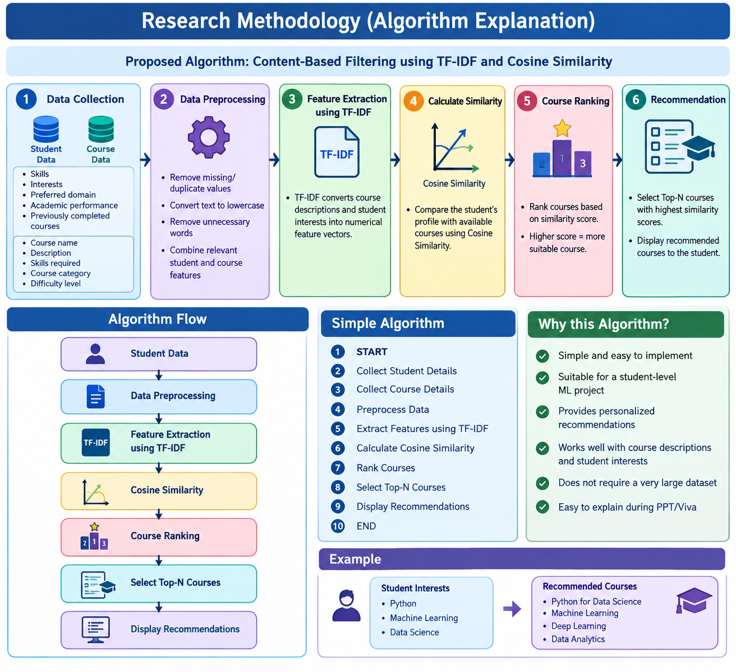
RESEARCH METHODOLOGY

Slide 10
COMPARE ALGORITHM
Criteria | Content-Based Filtering | Collaborative Filtering | Hybrid Recommendation
1. Input Data | Student & course features | Student-course history | Both
2. Technique | TF-IDF + Cosine Similarity | KNN / Matrix Factorization | CBF + CF
3. Personalization | High | High | Very High
4. Data Requirement | Low | High | Medium–High
5. Implementation | Easy | Moderate | Complex
6. Accuracy | Good | Good | Very Good
7. Cold Start | Low | High | Low–Medium
8. Explainability | High | Medium | High
9. Scalability | Good | Very Good | Good
10. Project Suitability | Excellent | Good | Very Good

Slide 11
IMPLEMENTION IDEA
Collect student details such as skills, interests, preferred domain, and academic performance.
Collect course details such as course name, description, category, skills, and difficulty level.
Preprocess the data by removing missing, duplicate, and unnecessary information.
Apply TF-IDF to convert student interests and course descriptions into numerical vectors.
Calculate Cosine Similarity to measure the match between the student profile and each course.
Rank the courses according to their similarity scores.
Recommend the Top-N most suitable courses to the student through a user-friendly interface.
Flow:
Student Data → Preprocessing → TF-IDF → Cosine Similarity → Course Ranking → Top-N Recommendations

Slide 12
MODULES
Student Profile Module
Collects student skills, interests, and experience.
Course Dataset Module
Stores course names, categories, skills, ratings, and descriptions.
Data Preprocessing Module
Cleans and prepares the dataset.
Recommendation Module
  Calculates similarity between student preferences and courses.
Result Module
  Displays the top recommended courses.

Slide 13
CONCLUSION
The Course Recommendation System helps students select suitable courses.
Machine Learning enables personalized and intelligent recommendations.
Content-Based Filtering and Cosine Similarity provide an effective basic recommendation approach.
The system can be further enhanced using advanced recommendation algorithms.

Slide 14
THANK YOU

